Slide 1
ENSE 374 Group Project
The R2D2s

Slide 2
Project Background
A movie database with all the information you might need for upcoming movies like release dates, what streaming services it will be on, trailers, etc. Users will be asked to sign up for an account. They will be able to rate and review movies/TV shows and the said reviews will be sorted according to the user's classes/faculty/school. There can also be a message board where the users will be able to engage with their peers. This service will allow the users to see what is popular with their peers and engage in (hopefully) productive discourse. There will be a tab with the latest industry news so that the users are in sync with the latest from Tinseltown.

Slide 3
Business Need
There are a lot of services that act as movie/TV show databases which will let you review a movie. There are a lot of services that will tell you what streaming service a media is on. But no one serves the most important media consuming demographic specifically. Our web-app will fill that void. Students will be able to easily find out their peers enjoy. Instead of reading a rating/review by anyone and everyone, they will be able to zoom in on what people their age, people with the same academic interest as them enjoy and share their opinions in a more personal environment.

Slide 4
MVPs
Users will be able to access a movie database and reviews by their peers.
Users have to enter the classes/faculties/institutions by themselves.
Ability to rate, review, and comment on the movies/TV shows.
Ability to find the streaming services.
Users have the ability to log in to their accounts and they get everything sorted into. They select their sorting criteria at the time of sign up.
Users have to manually change their credentials when they change.
The media will have discussion/message board sorted according to the user’s credentials

Slide 5
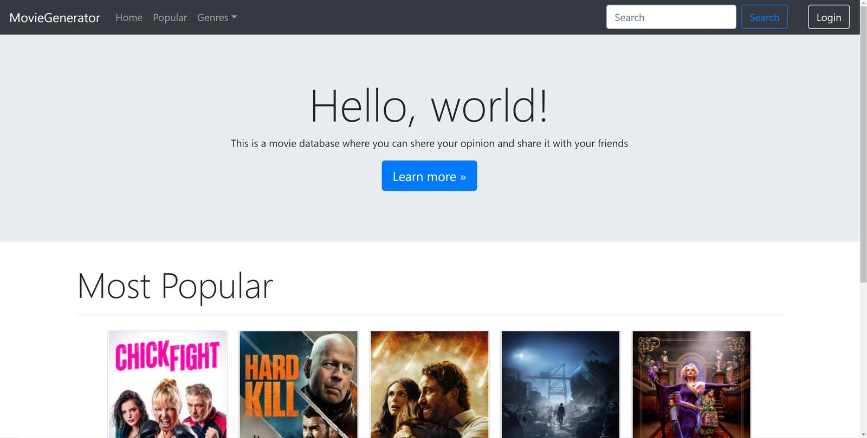
WebApp flow

Slide 6
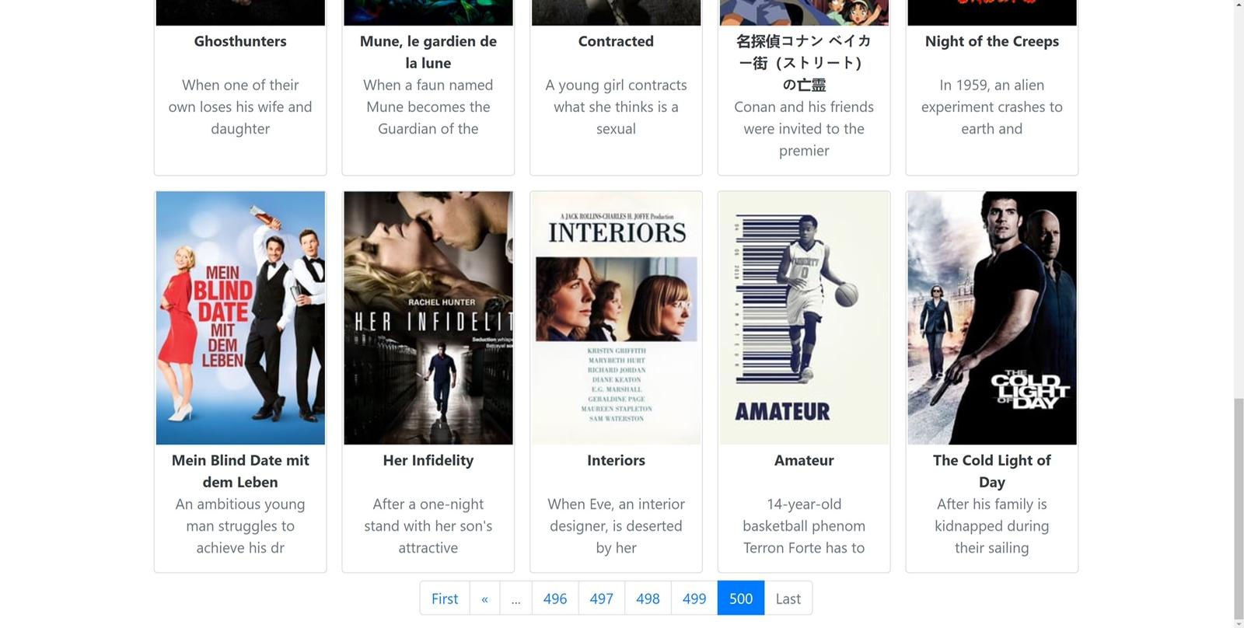

Slide 7
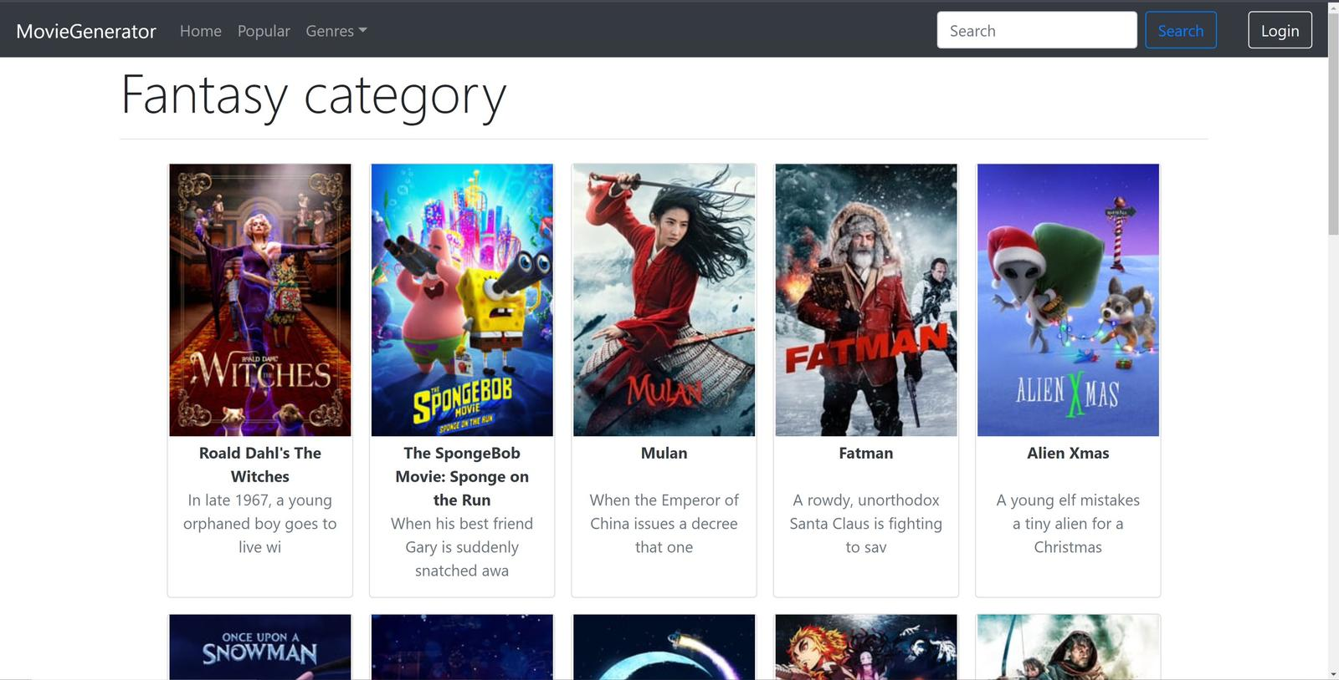

Slide 8
Q’s and (Hopefully)A’s

